Slide 1
: Infrastructure for Complete Machine Learning Lifecycle
Andrew Chen & Mani Parkhe
Sept 12th, 2018
Notes:
Thank audience
Introduce ourselves

Slide 2
Outline
ML development challenges
How MLflow tackles these
Demo
How to get started

Slide 3
Machine Learning Development is Complex

Slide 4

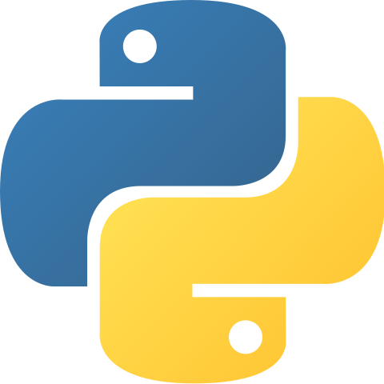
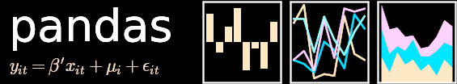

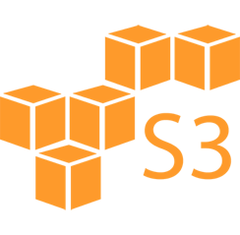






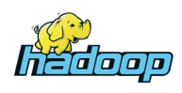




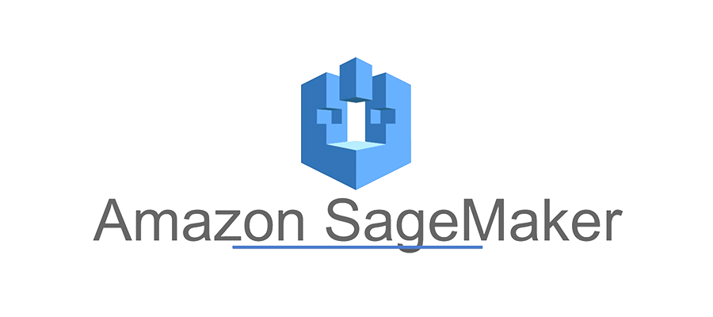

ML Lifecycle
μ
Tuning
λ
θ
Scale
Data Prep
μ
Tuning
Model
Exchange
λ
Raw Data
Training
θ
Delta
Scale
Scale
Deploy
Governance
Scale
Notes:
0. ML dev process: raw data -> prep (ETL and featurization) -> training -> deployment
Various tools. Best tool for each problem. Multiple tools
Various steps tuning and opimization: play with longer windows for feature, remember learning rate…
Scale: use all the data to improve results
Larger teams, isolation => model and data format for exchange. Changes in data storage format -> trickle in ETL changes -> …. Large teams, friction.
Governance of models and data: various models in testing. Audit an older model – observe data, retune it???

Slide 5
Example
“I build 100s of models/day to lift revenue, using any library: MLlib, PyTorch, R, etc. There’s no easy way to see what data went in a model from a week ago, tune it and rebuild it.”
-- Chief scientist at ad tech firm

Slide 6
Example
“Our company has 100 teams using ML worldwide. We can’t share work across them: when a new team tries to run some code, it often doesn’t even give the same result.”
-- Large consumer electronics firm

Slide 7
Custom ML Platforms
Facebook FBLearner, Uber Michelangelo, Google TFX
  Standardize the data prep / training / deploy loop:
  if you work with the platform, you get these!
  Limited to a few algorithms or frameworks
  Tied to one company’s infrastructure
Can we provide similar benefits in an open manner?
Notes:
How are the other big players in Machine Learning scaling out? Invested in platform team
POSITIVES : simplification by standardization. A set of tools for data prep, training and deploy. Usage ➔ more usage
NEGATIVE : limited models. Inflexibility of algorithms. Tied to company’s infra. Hard to open it to other users

Slide 8
Introducing
Open machine learning platform
  Works with any ML library & language
  Runs the same way anywhere (e.g. any cloud)
  Designed to be useful for 1 or 100,000 person orgs
Notes:
Mlflow brings about an innovation – as an open ML platform.
Work with any ML library/algorithm, language of choice. Not boxed into limited set of tools
- Design philosophy: API first, modular.
Submit runs in the same way anywhere. Local machine, any type of cloud
Reduce complexity and learning curve. Make it easy for 1 person to use it and scalable to 100K of user in an org.

Slide 9
MLflow Components
Standard packaging format for reproducible ML runs
  Folder of code + data files with a “MLproject” description file
Tracking
Projects
Models
Record and query
experiments: code,
configs, results, …etc
Packaging format
for reproducible runs
on any platform
General model format
that supports diverse
deployment tools

Slide 10
Demo

Slide 11
Goal: Predict Price of Airbnb Listings
listing attributes
bathrooms: 1
bedrooms: 2
accommodates: 4
total_reviews: 45
cleanliness_rating: 9
location_rating: 10
checkin_rating: 10
zip_code: 94105
f (x)
price: 150
Model
based on data from insideairbnb.com

Slide 12
MLflow Tracking
Notebooks
Python or REST API
Local Apps
UI
Tracking Server
API
Cloud Jobs

Slide 13
MLflow Projects
Local Execution
Project Spec
Code
Config
Data
Remote Execution

Slide 14
MLflow Models
Inference Code
Model Format
Flavor 1
Flavor 2
Batch & Stream Scoring
Run Sources
Simple model flavors usable by many tools
Cloud Serving Tools

Slide 15
Getting Started with MLflow
Install with pip install mlflow
Find detailed tutorials at mlflow.org
Sign up at databricks.com/mlflow for future updates

Slide 16
Ongoing MLflow Roadmap
TensorFlow, Keras, PyTorch, H2O, MLlib integrations ✔
Java and R language APIs (both in review!)
Multi-step workflows
Hyperparameter tuning
Data source API based on Spark data sources
Model metadata & management
Notes:
✔

Slide 17
Conclusion
Workflow tools can greatly simplify the ML lifecycle
  Improve usability for both data scientists and engineers
  Same way software dev lifecycle tools simplify development
Learn more about MLflow at mlflow.org

Slide 18
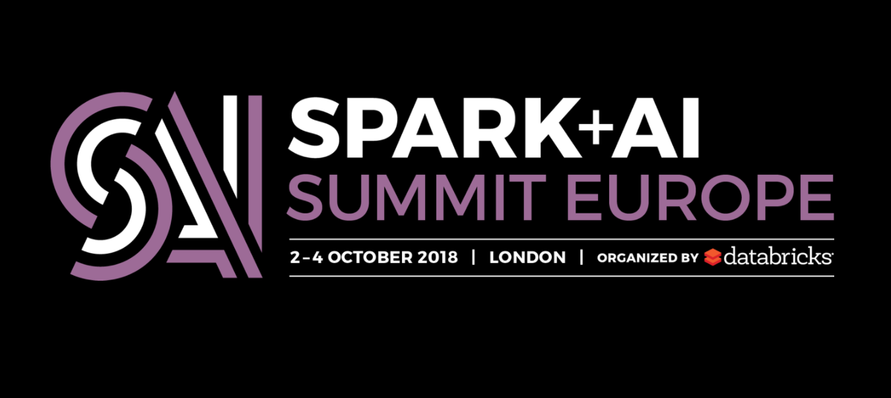
https://databricks.com/sparkaisummit/europe
30% Discount Code: Mani30

Slide 19
Thank you!

Slide 20
MLflow Design Philosophy
1. “API-first”, open platform
  Allow submitting runs, models, etc from any library & language
  Example: a “model” can just be a lambda function that MLflow can then deploy in many places (Docker, Azure ML, Spark UDF, …)
Key enabler: built around REST APIs and CLI
Notes:
Empower user to run their experiment using any tool/library and any language.
Similar flexibility to handle models.
Eg: various model packaging formats that work with different libraries (Onyx with Pytorch, TF, … etc) and various serving frameworks. Hard to integrate with everything. Mlflow has this pyfunc model flavor that exposes a python function interface that sends in data.

Slide 21
MLflow Design Philosophy
2. Modular design
  Let people use different components individually (e.g., use MLflow’s project format but not its deployment tools)
  Easy to integrate into existing ML platforms & workflows
Key enabler: distinct components (Tracking/Projects/Models)
Notes:
While we are designing a platform for various aspects of ML, does not make sense to build a monolithic platform that rigid in workflow stages
Flexibility to pick and choose components. Team really solid platform for deployment, Mlflow project (declare dependencies, setup environment, and parameters) and other people use it to do various runs by tweaking parameters.
Incremental build workflows.
Build smaller components that can use uses together but also used independently and added to existing workflows.

